Slide 1
Testing and Modeling users
Presented by 19SW39

Slide 2
01. User testing
.

Slide 3
TASK example
.
You want to make a readable document but
Using Notepad
Will you be able to make it readable

Slide 4
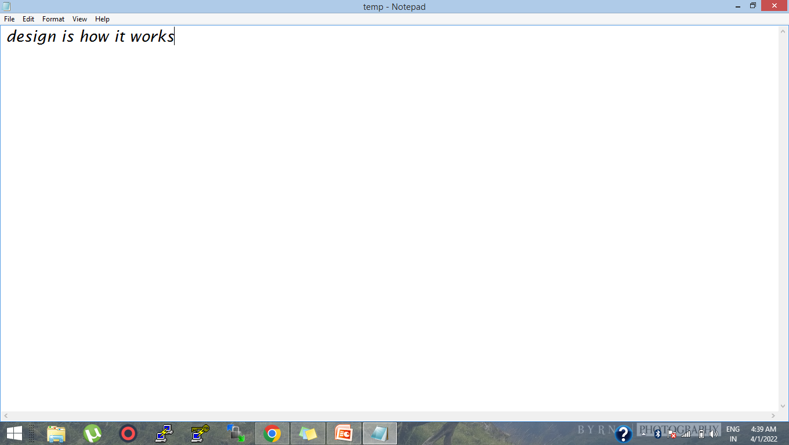
,
Before
Want to change the font size of specific word
,

Slide 5
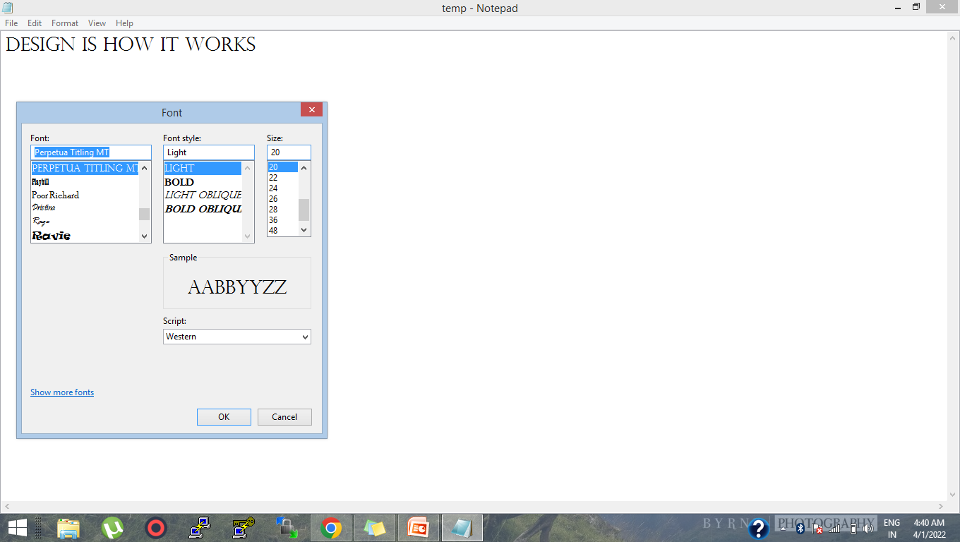
after
No
feature
available

Slide 6
NEED of USER TESTING
PROBLEM
GOAL .
need to improve interface design
Want to make demanded product for the users
With delightful user experience
Notes:
Users are not able to use the System easily
System is not helping them
to achieve their task
users are unsatisfactory
with the features of the system
Need to design such interface
through which user can
easily use the system to
achieve the goal of using it
inefficient Task performance

Slide 7

the solution , User Testing
.
“
Uncovering the experience of using the product by actually talking to users and watching them interacting with your product
“

Slide 8
User Testing continue
During test ,
record and observe a set of user’s performing tasks with a product to find errors and areas of improvement for product development.
asking a user how the quality of the experience was for them
Helps us to understand the demand of app /website .
How will they use the app /website ?

Slide 9
Variety of user testing
INCLUDING ,
Usability testing
Eye tracking

Slide 10
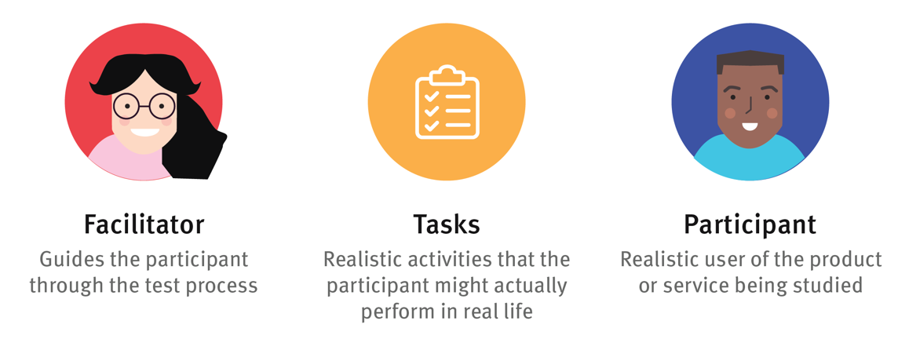
Performing user test elements of user test

Slide 11
01
02
Identify task scenarios
Recruit participants
03
04
Perform the test
Analyze the results
test user flows , whether the understanding the flow of steps is confusing in performing the task
selecting individuals who matches with the created personas
prepare the user for what they are about to do , what the user is supposed to do. What do you test, what product,
discover points of improvement

Slide 12

To examine the physical behavior of users and their interaction with the product which was observed through user testing

Slide 13
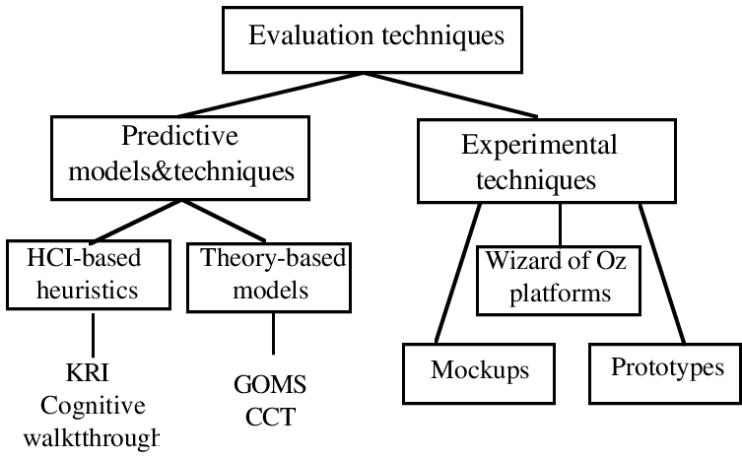
.

Slide 14
02. User Modeling
.

Slide 15
Predictive Models -controlled variables, statistics
GOMS - Goals, Operators, Methods and Selection rules
KLM - Keyboard-Level Model (a variation of GOMS)
FITTs law

Slide 16
GOMS
GOMS stands for:Goals Operators, Methods, Selection Rule
GOMS is a method for examining the individual components of a user experience in terms of the time it takes a user to most efficiently complete a goal.

Slide 17
GOMs example the use-mouse-delete-word method
Goals:High level goal (e.g. WRITE-REPORT) or low level (e.g. DELETE-WORD)
Operators:Perceptual, motor or cognitive actions that are used to accomplish the goals (e.g. DOUBLE- CLICK-MOUSE, PRESS-INSERT-KEY). Each operator requires a fixed amount of time for the user to execute,
e.g. CLICK-MOUSE button takes 0.20 seconds to execute).
Methods:procedures the user uses to accomplish a goal.
For example, one method to accomplish the goal DELETE-WORD would be to MOVE-MOUSE to the beginning of the word, and PRESS- DELETE-KEY (the use-mouse-delete-word method).

Slide 18
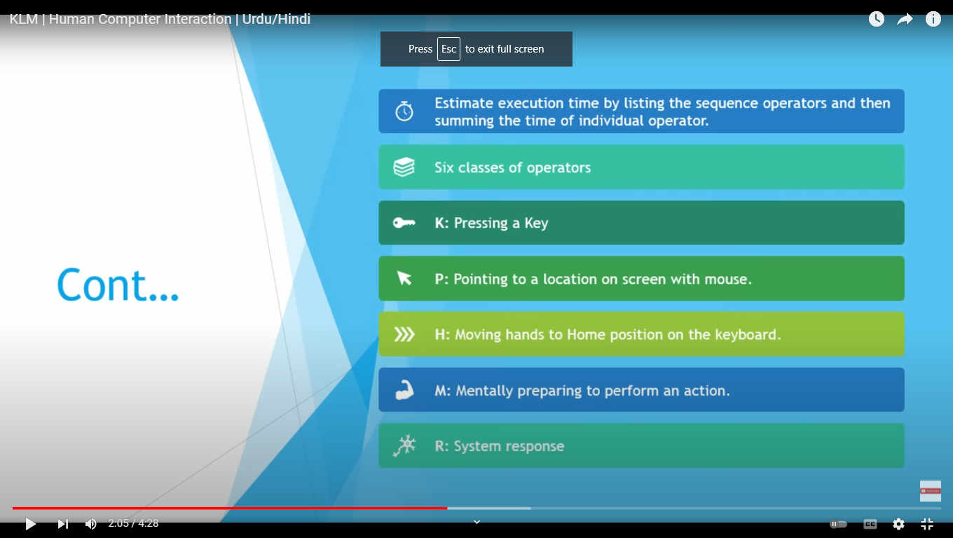
KLM Keyboard-Level Model (a variation of GOMS)

Slide 19
KLM

Slide 20
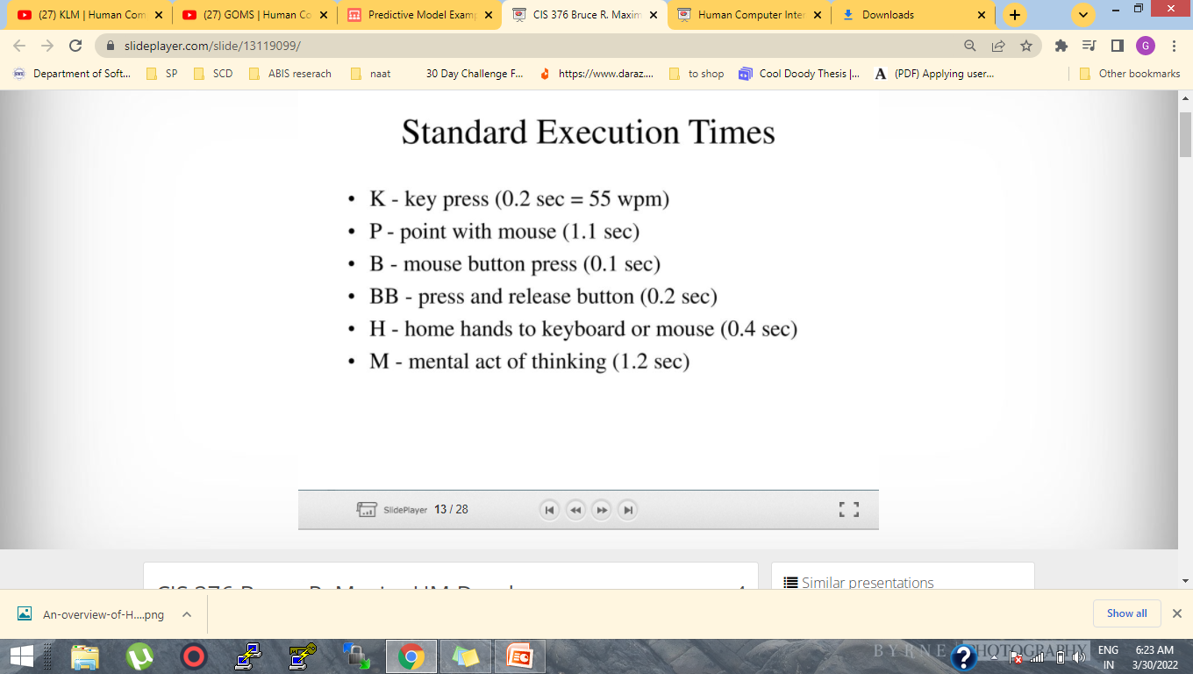
KLM

Slide 21
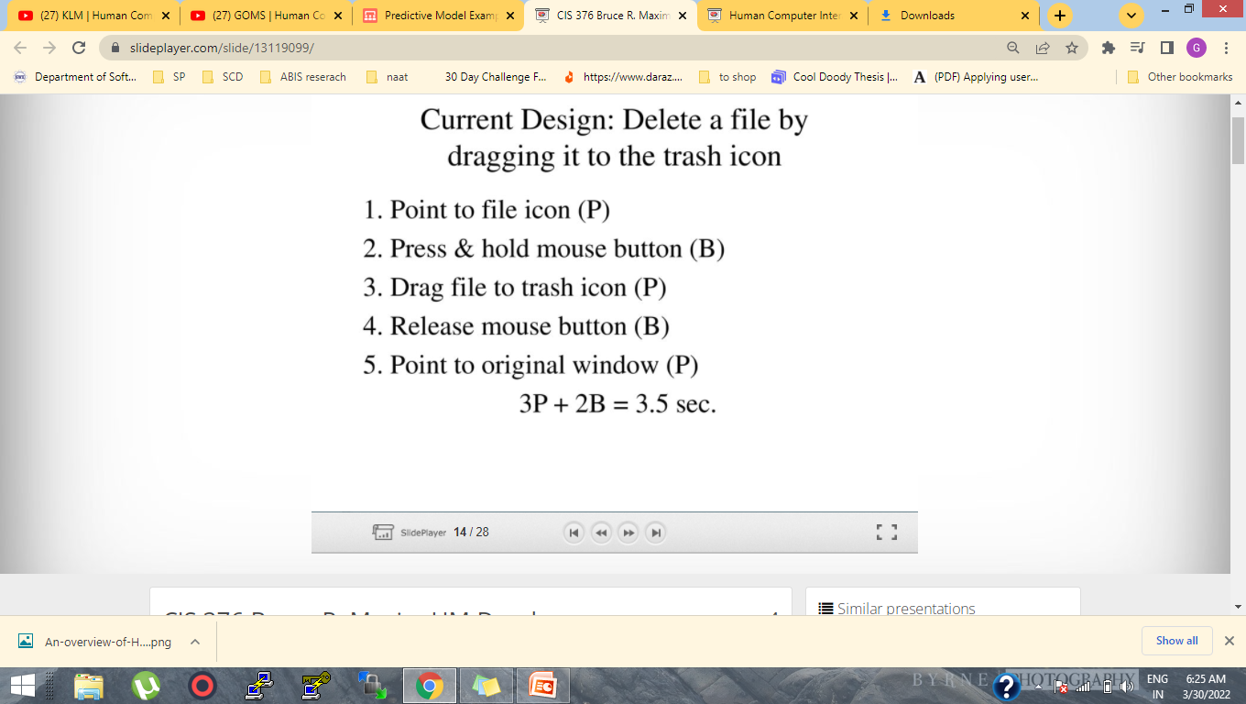
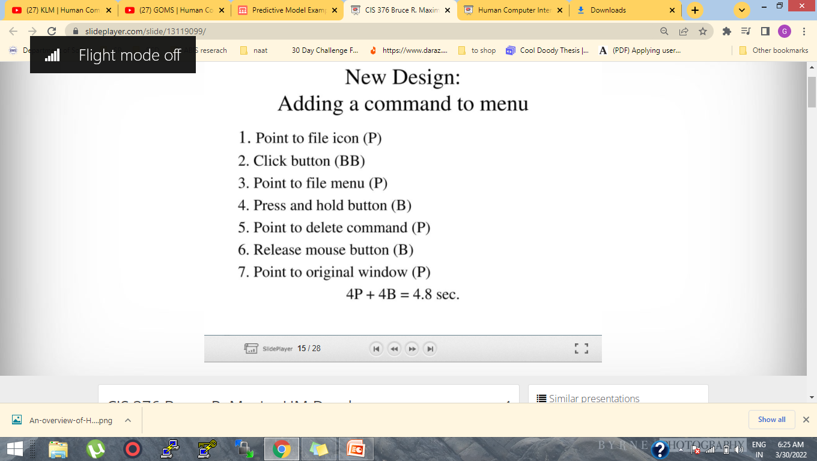
KLM example

Slide 22
REFRENCES
http://thinkapps.com/blog/design/user-testing-guide/
https://uxplanet.org/the-case-for-user-testing-87d82da3c19c
https://www.youtube.com/watch?v=vlltJl61bvo
https://www.youtube.com/watch?v=mymwjCCa1bQ
https://slideplayer.com/slide/download/

Slide 23
THANKS!
Please keep this slide for attribution

